Slide 1
4-BIT COMPARATOR
BY
JAY KHAPLE
M.MANOJ

Slide 2
.
Aim
To study and Implement 4-Bit Magnitude Comparator IN XILINX VIVADO
Learning Objectives
To understand the behavior and demonstrate the Implementation of 4-Bit Magnitude Comparator To apply knowledge of the fundamental gates to create truth tables.
To develop digital circuit building and troubleshooting skills.
To examine the output according to the inputs
To understand key elements Of 4 bit comparator
To implement and observe the output on FPGA board

Slide 3
Digital Comparator
A magnitude digital comparator is a combinational circuit that compares two digital or binary numbers (consider A and B) and determines their relative magnitudes in order to find out whether one number is equal, less than or greater than the other digital number.
Three binary variables are used to indicate the outcome of the comparison as A>B, A<B, or A=B. The below figure shows the block diagram of a n-bit comparator which compares the two numbers of n-bit length and generates their relation between themselves.
Digital comparators can be of two types
Identity Comparator
Comparators that have only one output terminal and produces the output either low or high are identity comparators.
Magnitude Comparator
Comparators with three output terminals and checks for three conditions i.e greater than or less than or equal to is magnitude comparator.

Slide 4
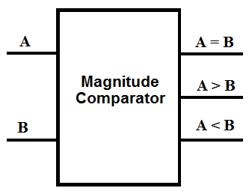
.
Digital Magnitude Comparators are made up from standard AND, NOR and NOT gates that compare the digital signals present at their input terminals and produce an output depending upon the condition of those inputs. Here, two 4-bit words (“nibbles”) are compared to each other to produce the relevant output with one word connected to inputs A and the other to be compared against connected to input B as shown below. itude Comparators
A magnitude comparators performs the comparison by analysing all the factors. It shows results for either greater(>), equal(=) or lesser than(<) value by comparing the magnitude of two inputs.

Slide 5
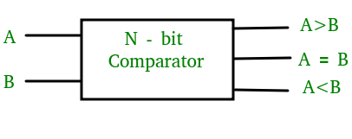
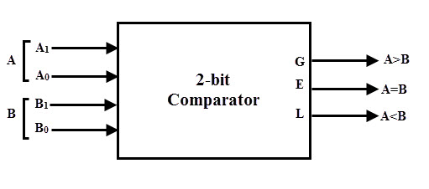
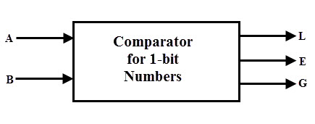
DIFFERENT TYPES OF COMPARATORS
Single Bit Magnitude Comparator
2-Bit Comparator
4-Bit Comparator
8-Bit Comparator

Slide 6
Applications of Comparators
These are used in the address decoding circuitry in computers and microprocessor based devices to select a specific input/output device for the storage of data.
These are used in control applications in which the binary numbers representing physical variables such as temperature, position, etc. are compared with a reference value. Then the outputs from the comparator are used to drive the actuators so as to make the physical variables closest to the set or reference value.
Process controllers
Servo-motor control

Slide 7
4-BIT COMPARATOR
4-Bit Magnitude Comparator:
A comparator used to compare two binary numbers each of four bits is called a 4-bit magnitude comparator. It consists of eight inputs each for two four-bit numbers and three outputs to generate less than, equal to, and greater than between two binary numbers.
In a 4-bit comparator the condition of A>B can be possible in the following four cases:
If A3 = 1 and B3 = 0
If A3 = B3 and A2 = 1 and B2 = 0
If A3 = B3, A2 = B2 and A1 = 1 and B1 = 0
If A3 = B3, A2 = B2, A1 = B1 and A0 = 1 and B0 = 0

Slide 8
.
Similarly the condition for A<B can be possible in the following four cases:
If A3 = 0 and B3 = 1
If A3 = B3 and A2 = 0 and B2 = 1
If A3 = B3, A2 = B2 and A1 = 0 and B1 = 1
If A3 = B3, A2 = B2, A1 = B1 and A0 = 0 and B0 = 1
The condition of A=B is possible only when all the individual bits of one number exactly coincide with corresponding bits of another number.

Slide 9
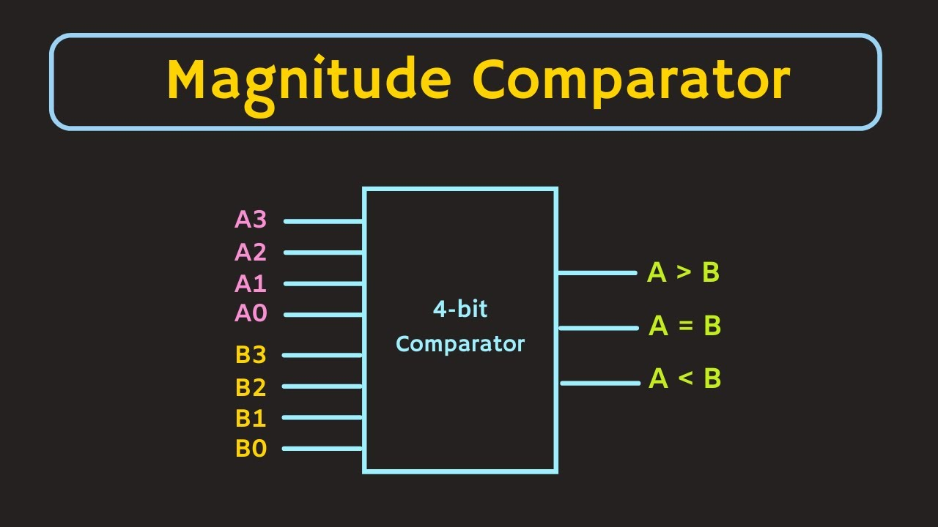
.

Slide 10
How to design a 4–bit comparator?
From the above statements logical expressions for each output can be expressed as follows:
AA, 831331 r: (A3 EioNor 33)A2132′ a (A3 Ex-Nor 133) (A2 Ex-Nor 132)A131′ a (A3 Ex-Nor 33) (A2 ENor132) (Al Ex-Nor 31)A01301 ,13: A3’03 a (A3 Ex-Nor 33)A211:12 a (A3 Ex-Nor 83) (A2 Ex-Nor 132)Ar131 a (A3 Ex-Nor 33) (A2 Ex-Nor32) (Al Ex-Nor 131)A0N30 A=B: (A3 Ex-Nor B3) (A2 Ex-Nor 82) (Al Ex-Nor BI) (AO Ex-Nor BO)
By using these Boolean expressions, we can implement a logic circuit for this comparator as given below:

Slide 11
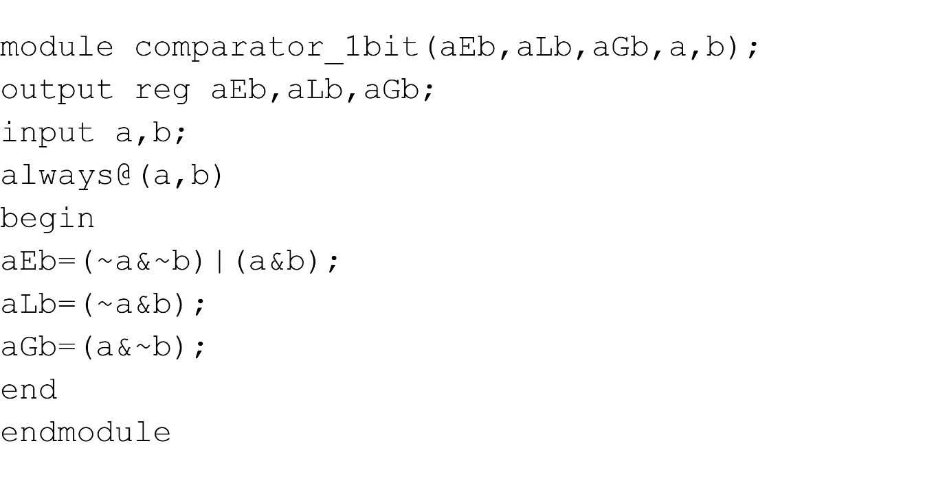
.

Slide 12
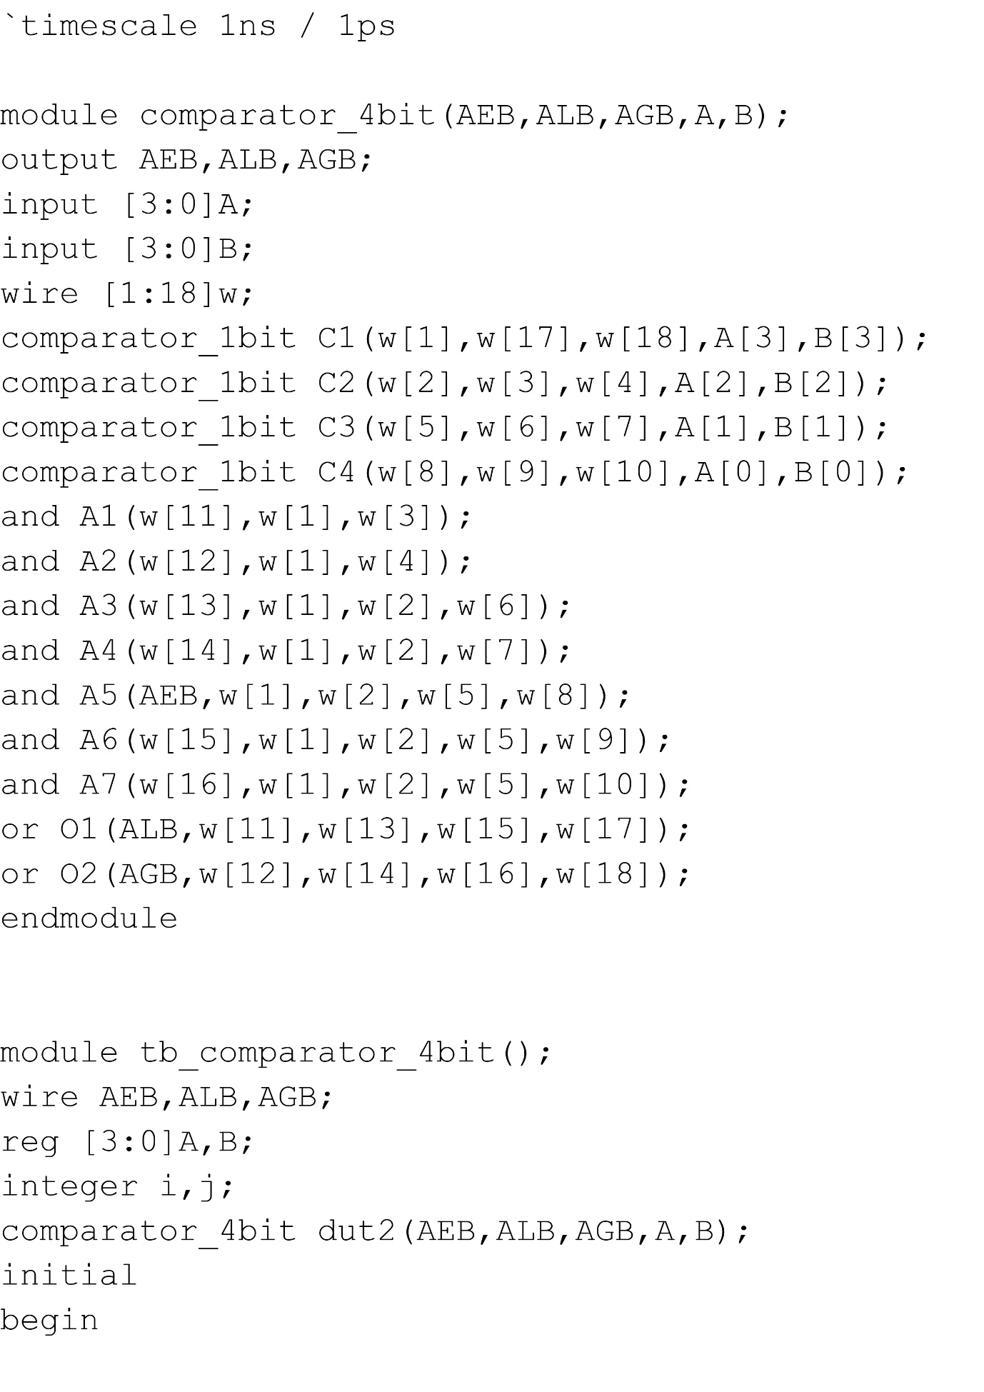
PROGRAM FOR 4- BIT COMPARATOR

Slide 13
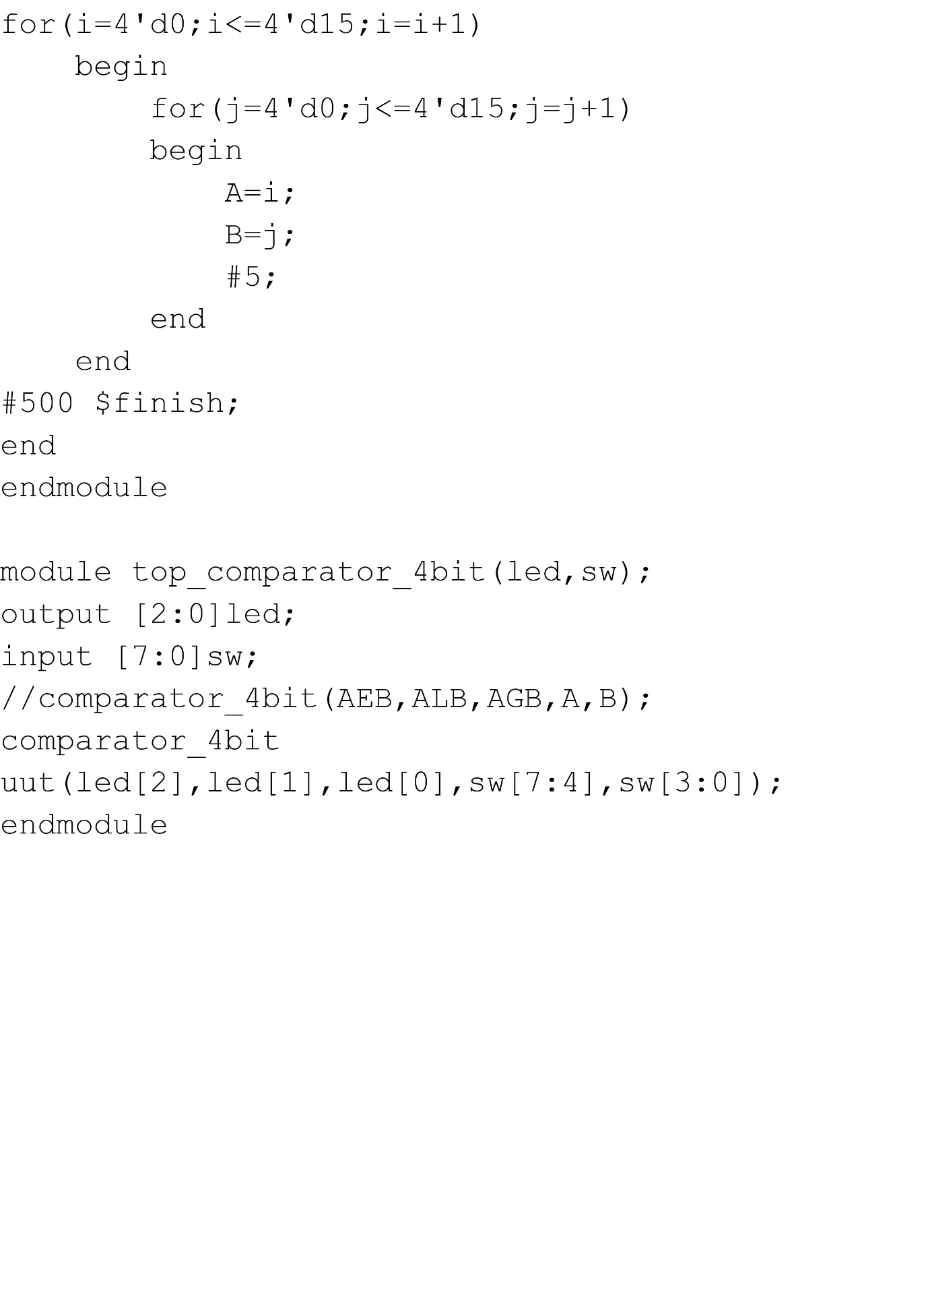
.

Slide 14
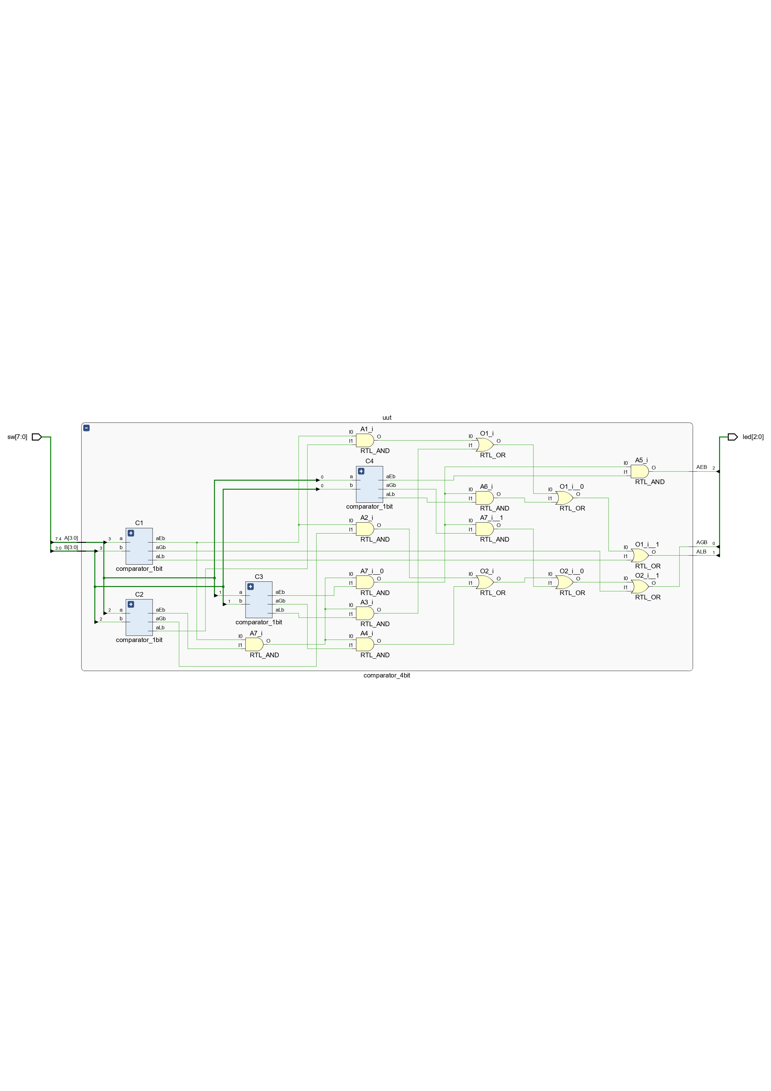
CIRCUIT DIAGRAM

Slide 15
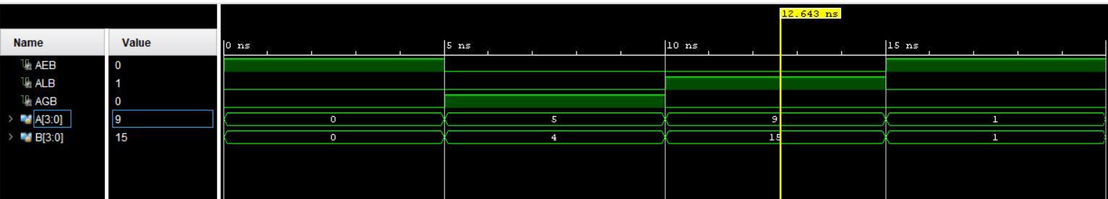

Slide 16
Thank you…

